Slide 1


Sentimental Analysis
AMAZON PRODUCT REVIEW

Slide 2
INTRODUCTION
This project is based on Amazon product reviews
Business needs: Perform a Sentiment Analysis on the dataset shared, bucket the reviews by emotions to mine the opinion and overall sentiment of the consumers by product
This dataset contains 33332 records each representing customer Reviews and 7 features
Important features of the dataset
Product name,
product reviews
Commented date.

Slide 3
PREPROCESSING
Preprocessing steps – Null value checking
Duplicate Checking
Punctuation Removal
Stopwords Removal
URL Removal
Stemming
Lemmatization
Tokenization

Slide 4
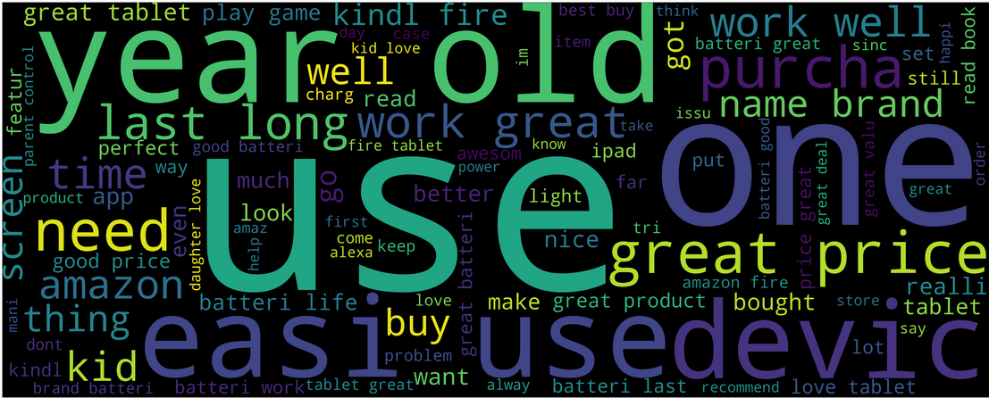
WORDCLOUD

Slide 5
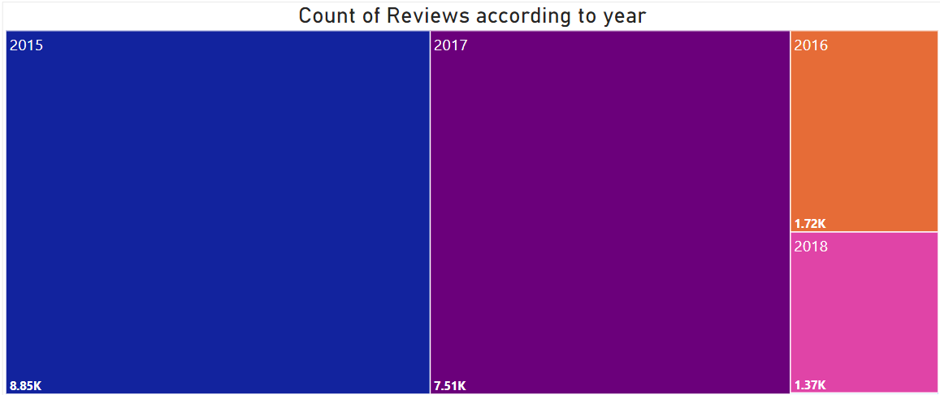
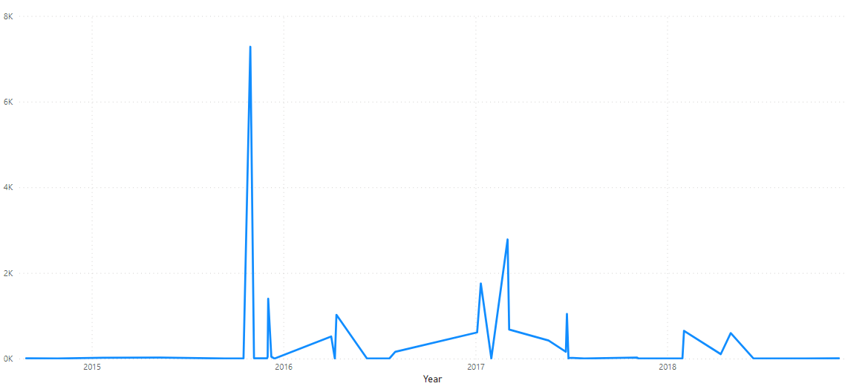

Slide 6
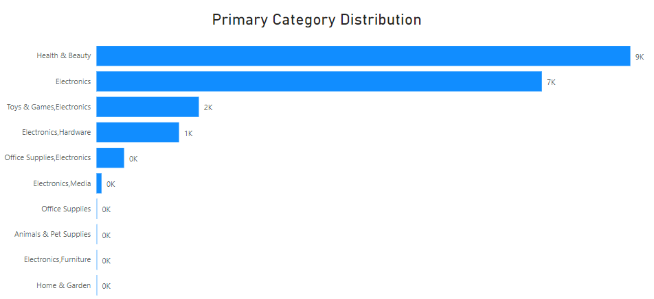
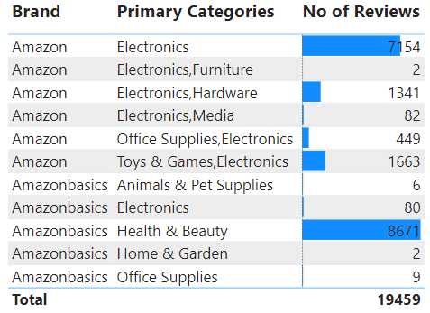
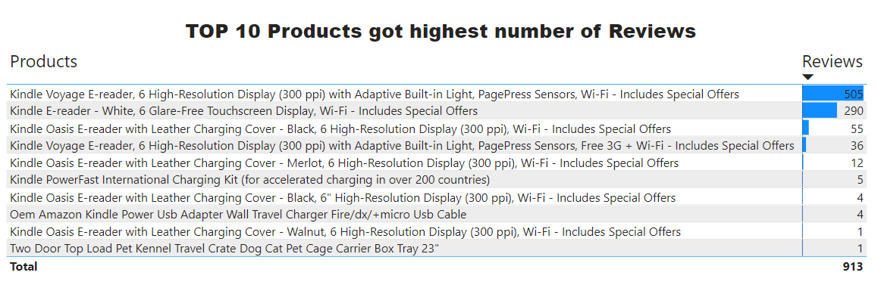

Slide 7
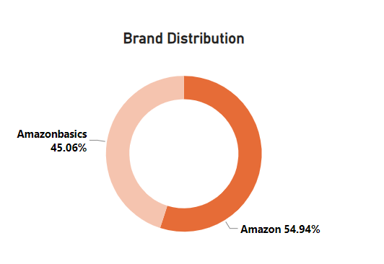
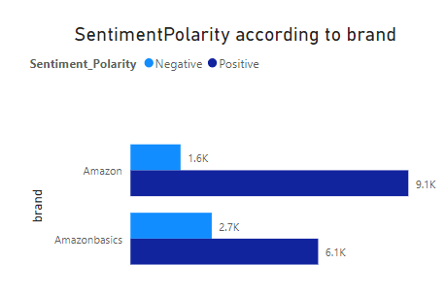
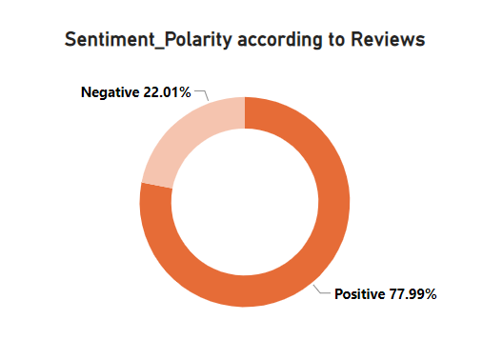
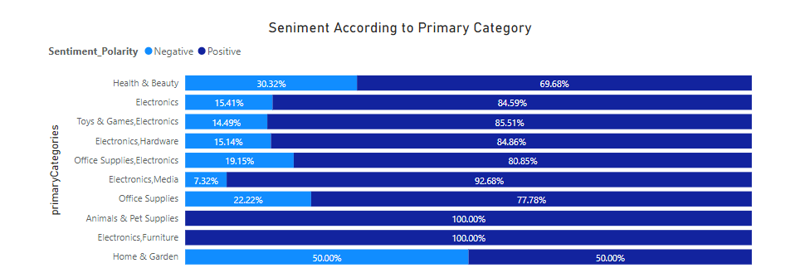

Slide 8
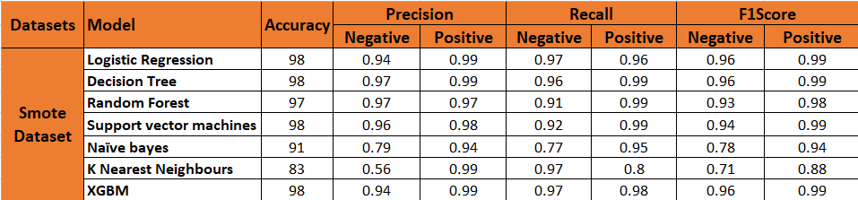
MODEL BUILDING
BEFORE SMOTE
AFTER SMOTE
Smote technique was used to balance the Dataset.
Performed different classification models.
Logistic Regression model is chosen for the Deployment

Slide 9
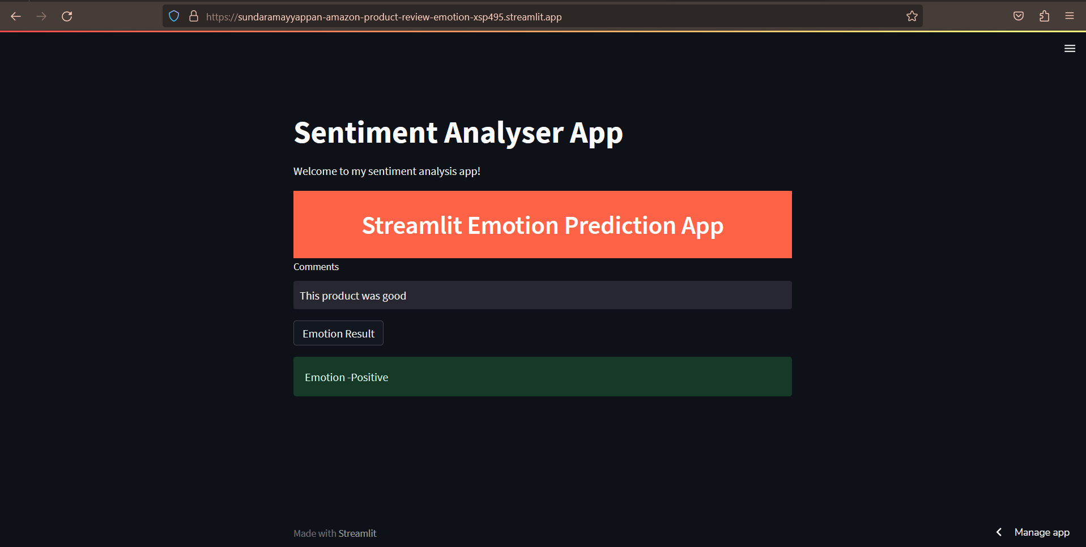
Deployment Link - https://sundaramayyappan-amazon-product-review-emotion-xsp495.streamlit.app/

